Slide 1
Course Overview
Programming Usable Interfaces (PUI)
05-430 / 05-630 Fall 2018
Jason Hong
jasonh@cs.cmu.edu

Slide 2
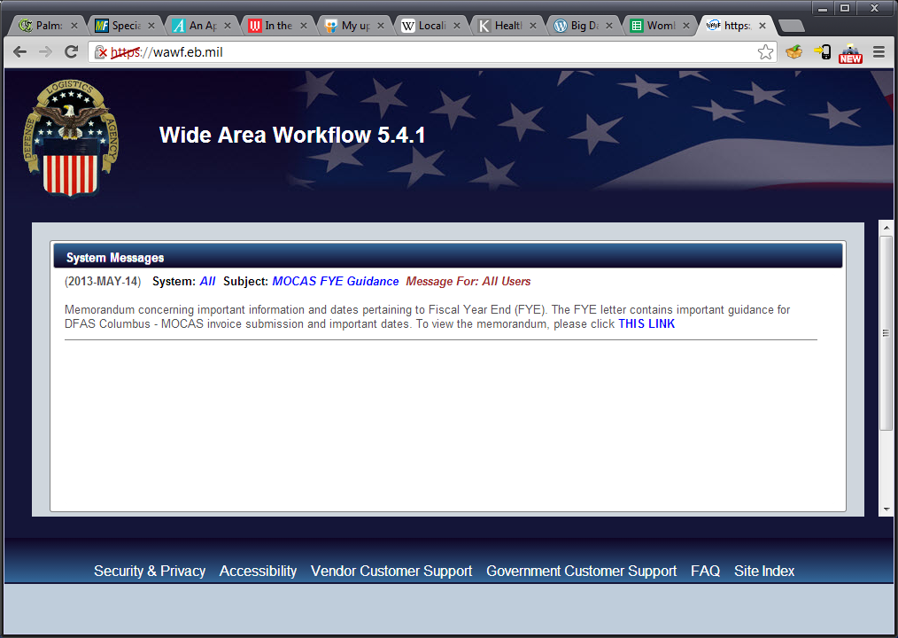
UI Hall of Fame or Shame?
Notes:
This is the Wide Area Workflow site. This is the site where you can submit invoices to the US government if you have a contract. Now, imagine you just came to this site for the first time. Tell me about what you see.

Slide 3
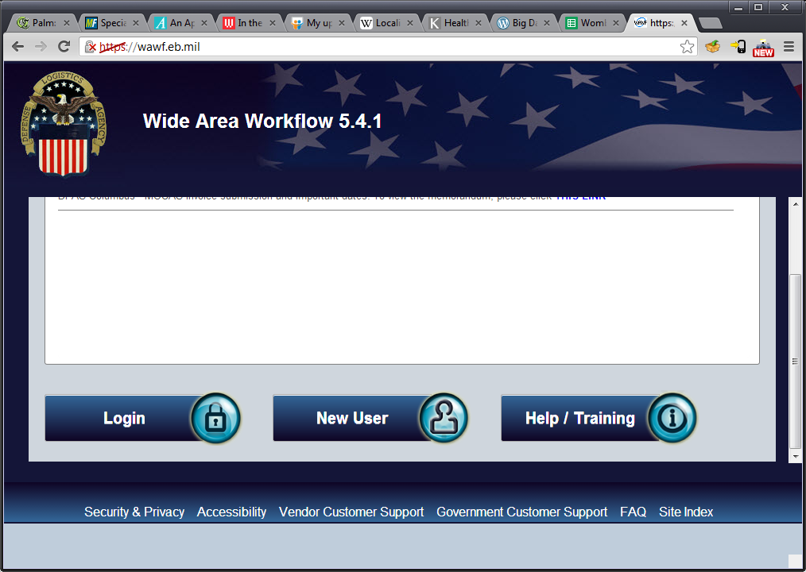
UI Hall of Fame or Shame?
Notes:
The problem on the previous screen is that there’s no clear action at all of what to do. It turns out that you have to scroll down to see the important parts, ie login, new user, etc.
There’s also this weird grey area on the bottom which wasn’t used, not sure why.

Slide 4
UI Hall of Fame or Shame?
Example of Above the Fold design pattern
You want most important things to be immediately obvious and readily available on screens
We’ll go more into design patterns later on in semester

Slide 5
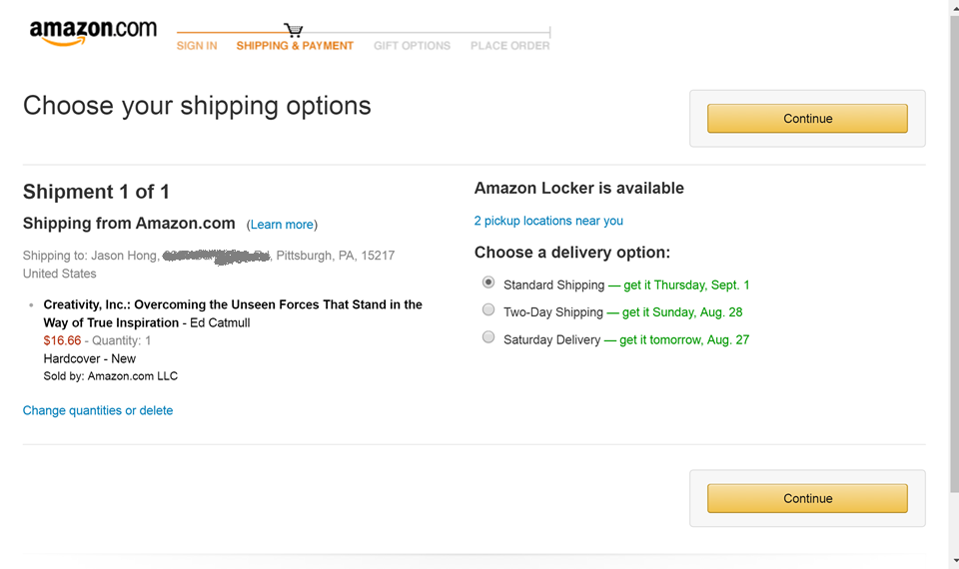
Another Example
Notes:
Q: Given what we just talked about, what’s interesting about this screen?
Note how Amazon’s checkout process makes the “Continue” button visually salient. The color draws your eye to it, and it’s the only real action you can do. Also, it has the button at the top and bottom, making it so that it will be visible regardless of scrolling.

Slide 6
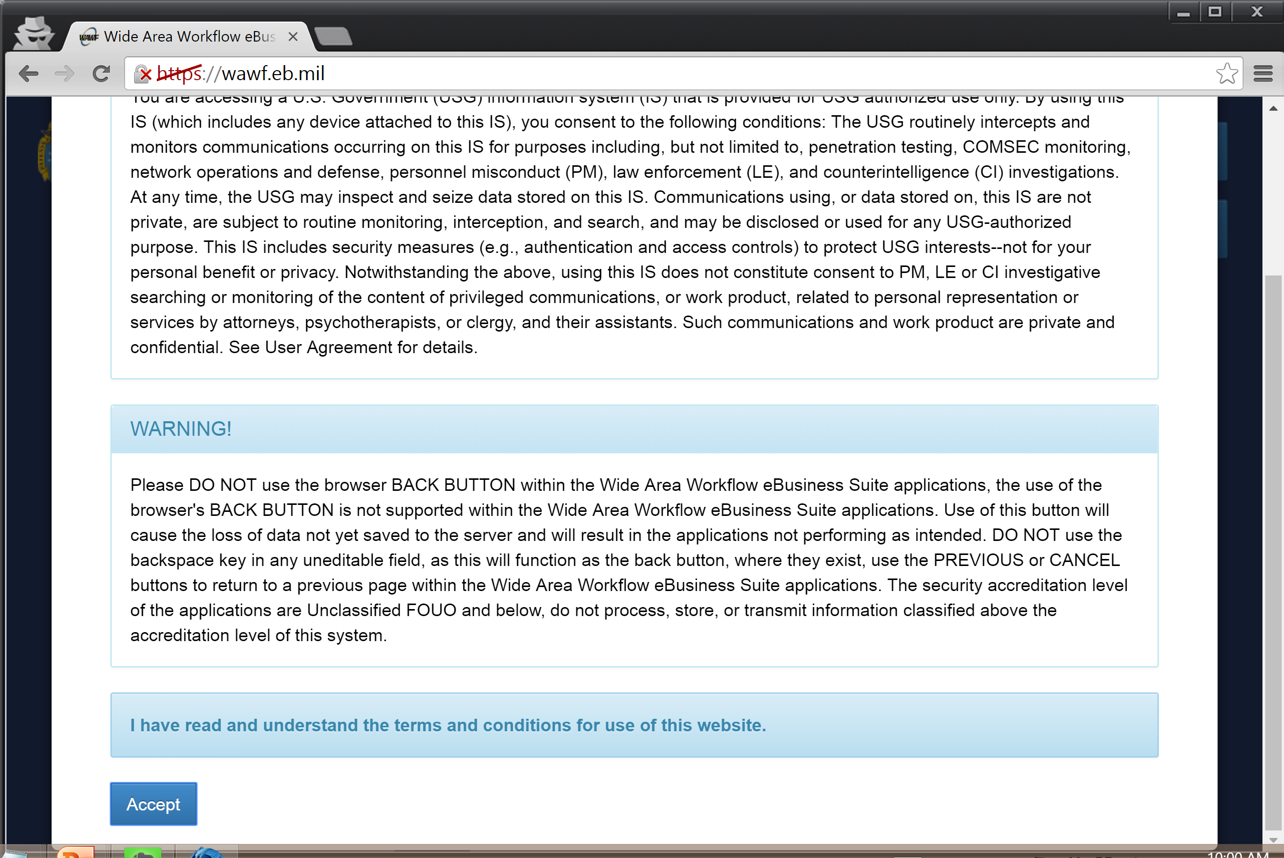
Updated Version of WAWF
Notes:
Here’s what the current version of WAWF looks like.
Hits you with this giant notice first.

Slide 7
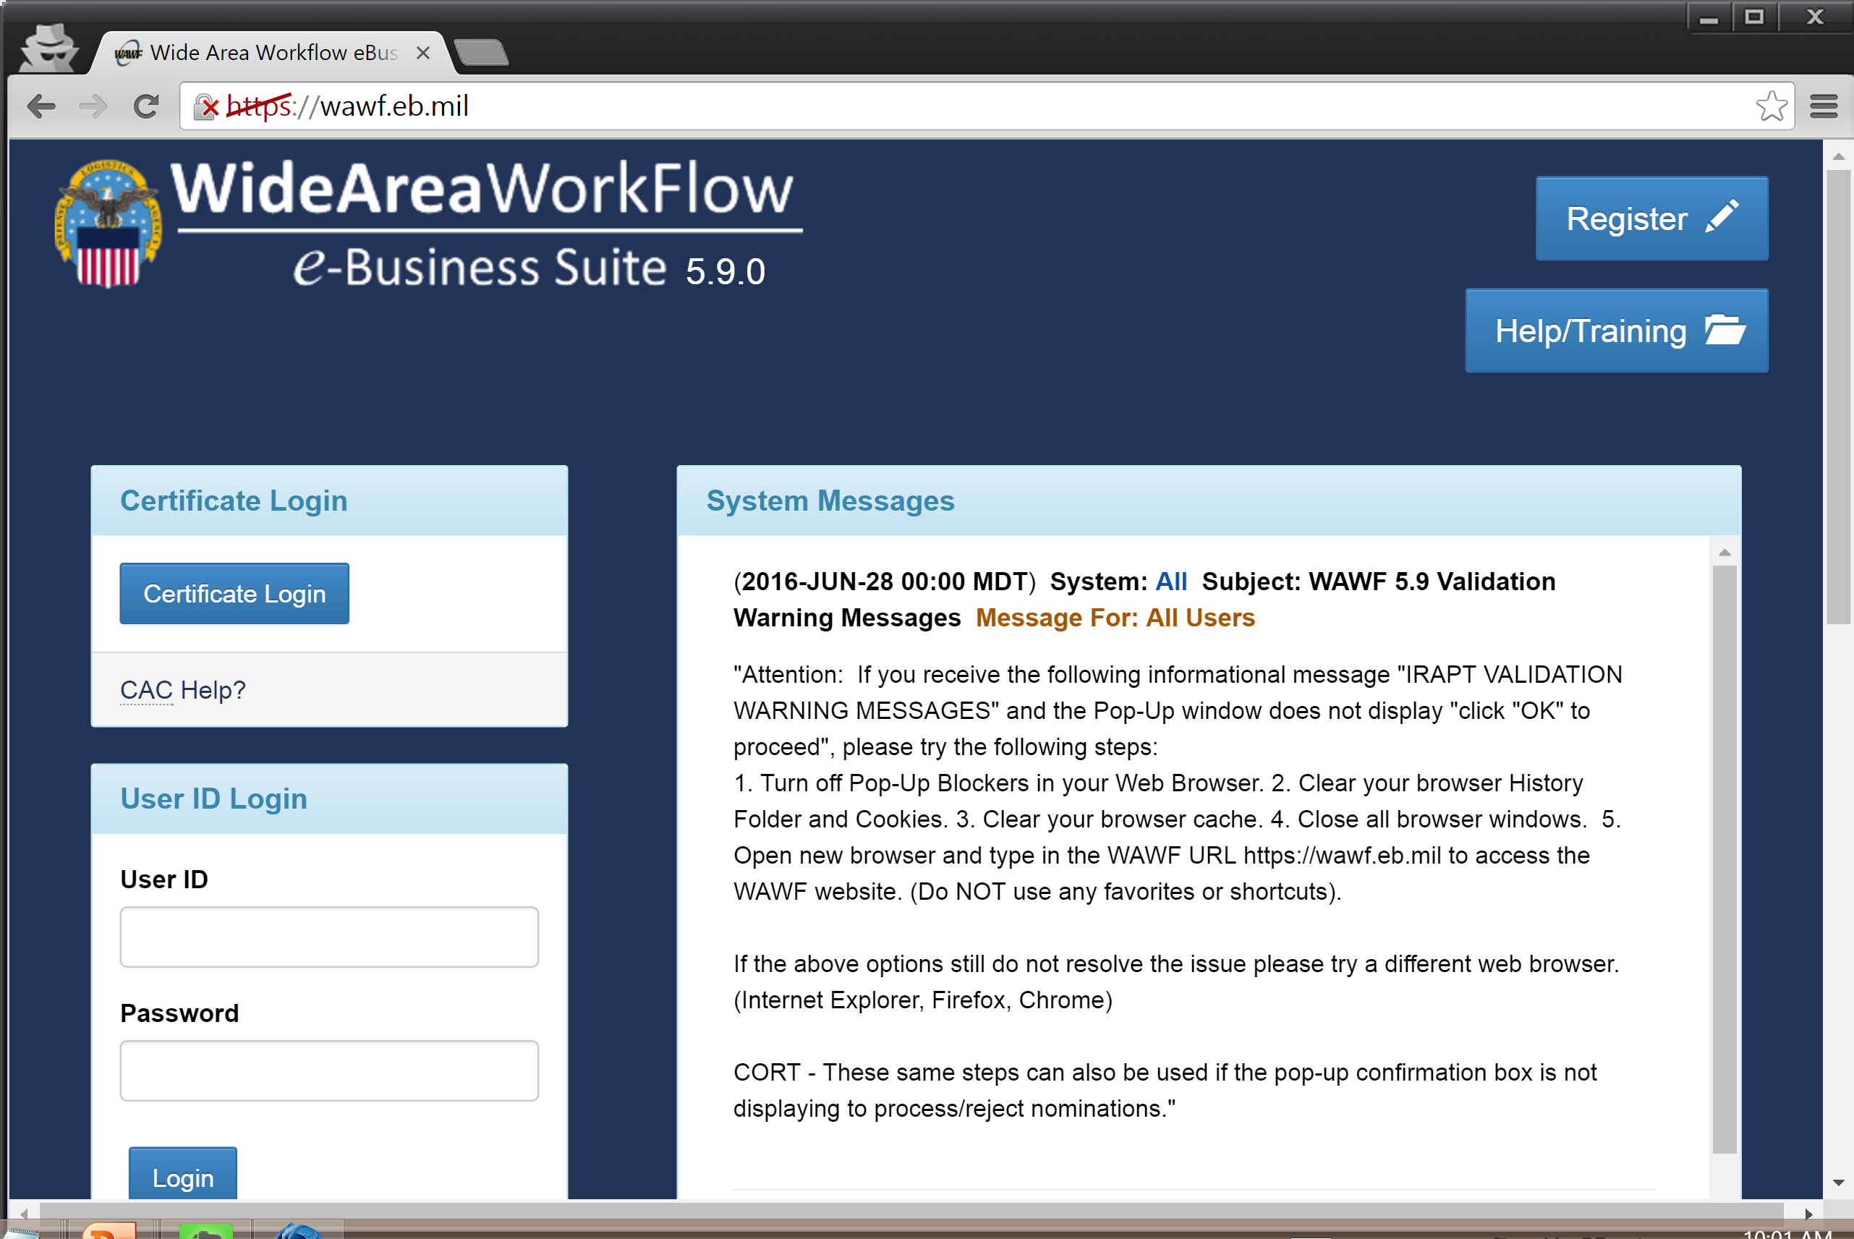
Updated Version of WAWF
Notes:
But at least they fixed the problem of what you can do on the front page

Slide 8


About Us
Jason Hong
Professor in HCII
Undergrad Georgia Tech, PhD Berkeley
You can call me Jason, Dr. Hong, Prof Hong, or Jedi Master Hong
Research in mobility, privacy, security
Co-author
Co-founder Wombat Security
Software used by millions
Acquired by Proofpoint March2018

Slide 9
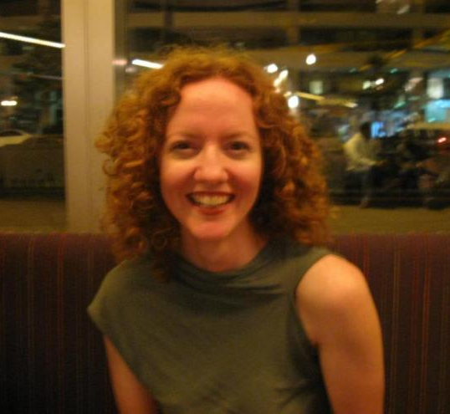

About Us
Kristin Williams
3rd year PhD student
Research in Accessibility tech
Section A (Mon lab)
Likes to race sailboats, survived a capsizing
Cole Gleason
3rd year PhD student
Accessibility tech for the blind
Section B (Mon lab)
Is really, really into BBQ
Update slide

Slide 10
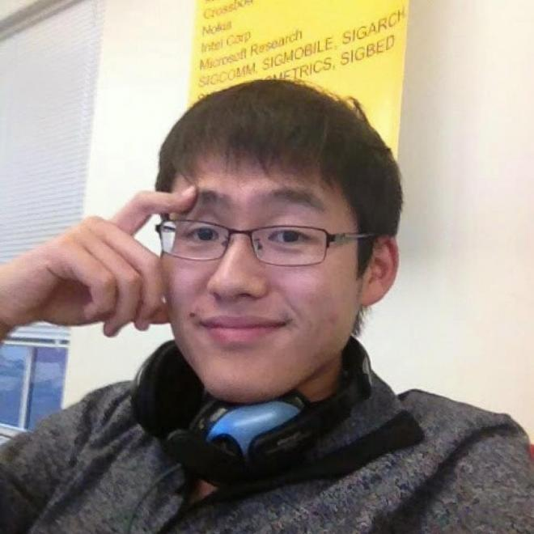
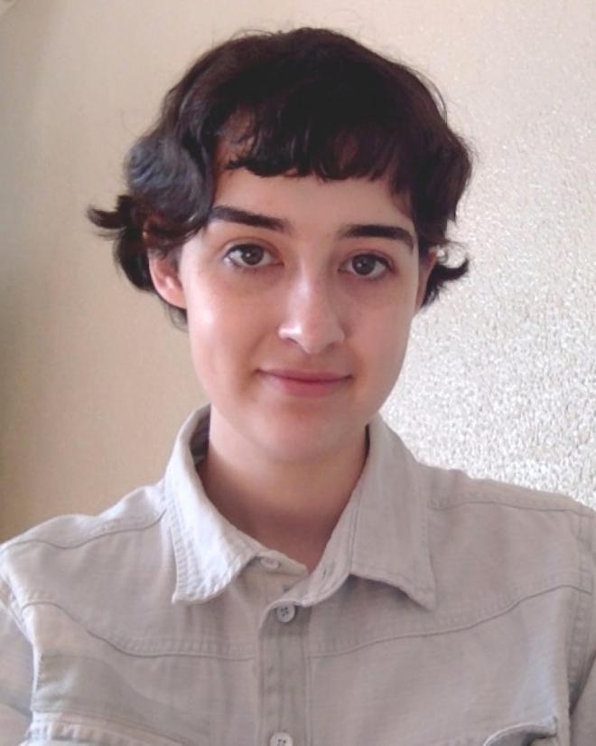
About Us
Fanglin Chen
3rd year PhD student
Intelligent agents for mobile
Section C (Wed lab)
Mary Beth Kery
4th year PhD student
Exploratory programming
Section D (Wed SSUI lab)
Update slide

Slide 11
What is This Course About?
What do the following have in common?

Slide 12
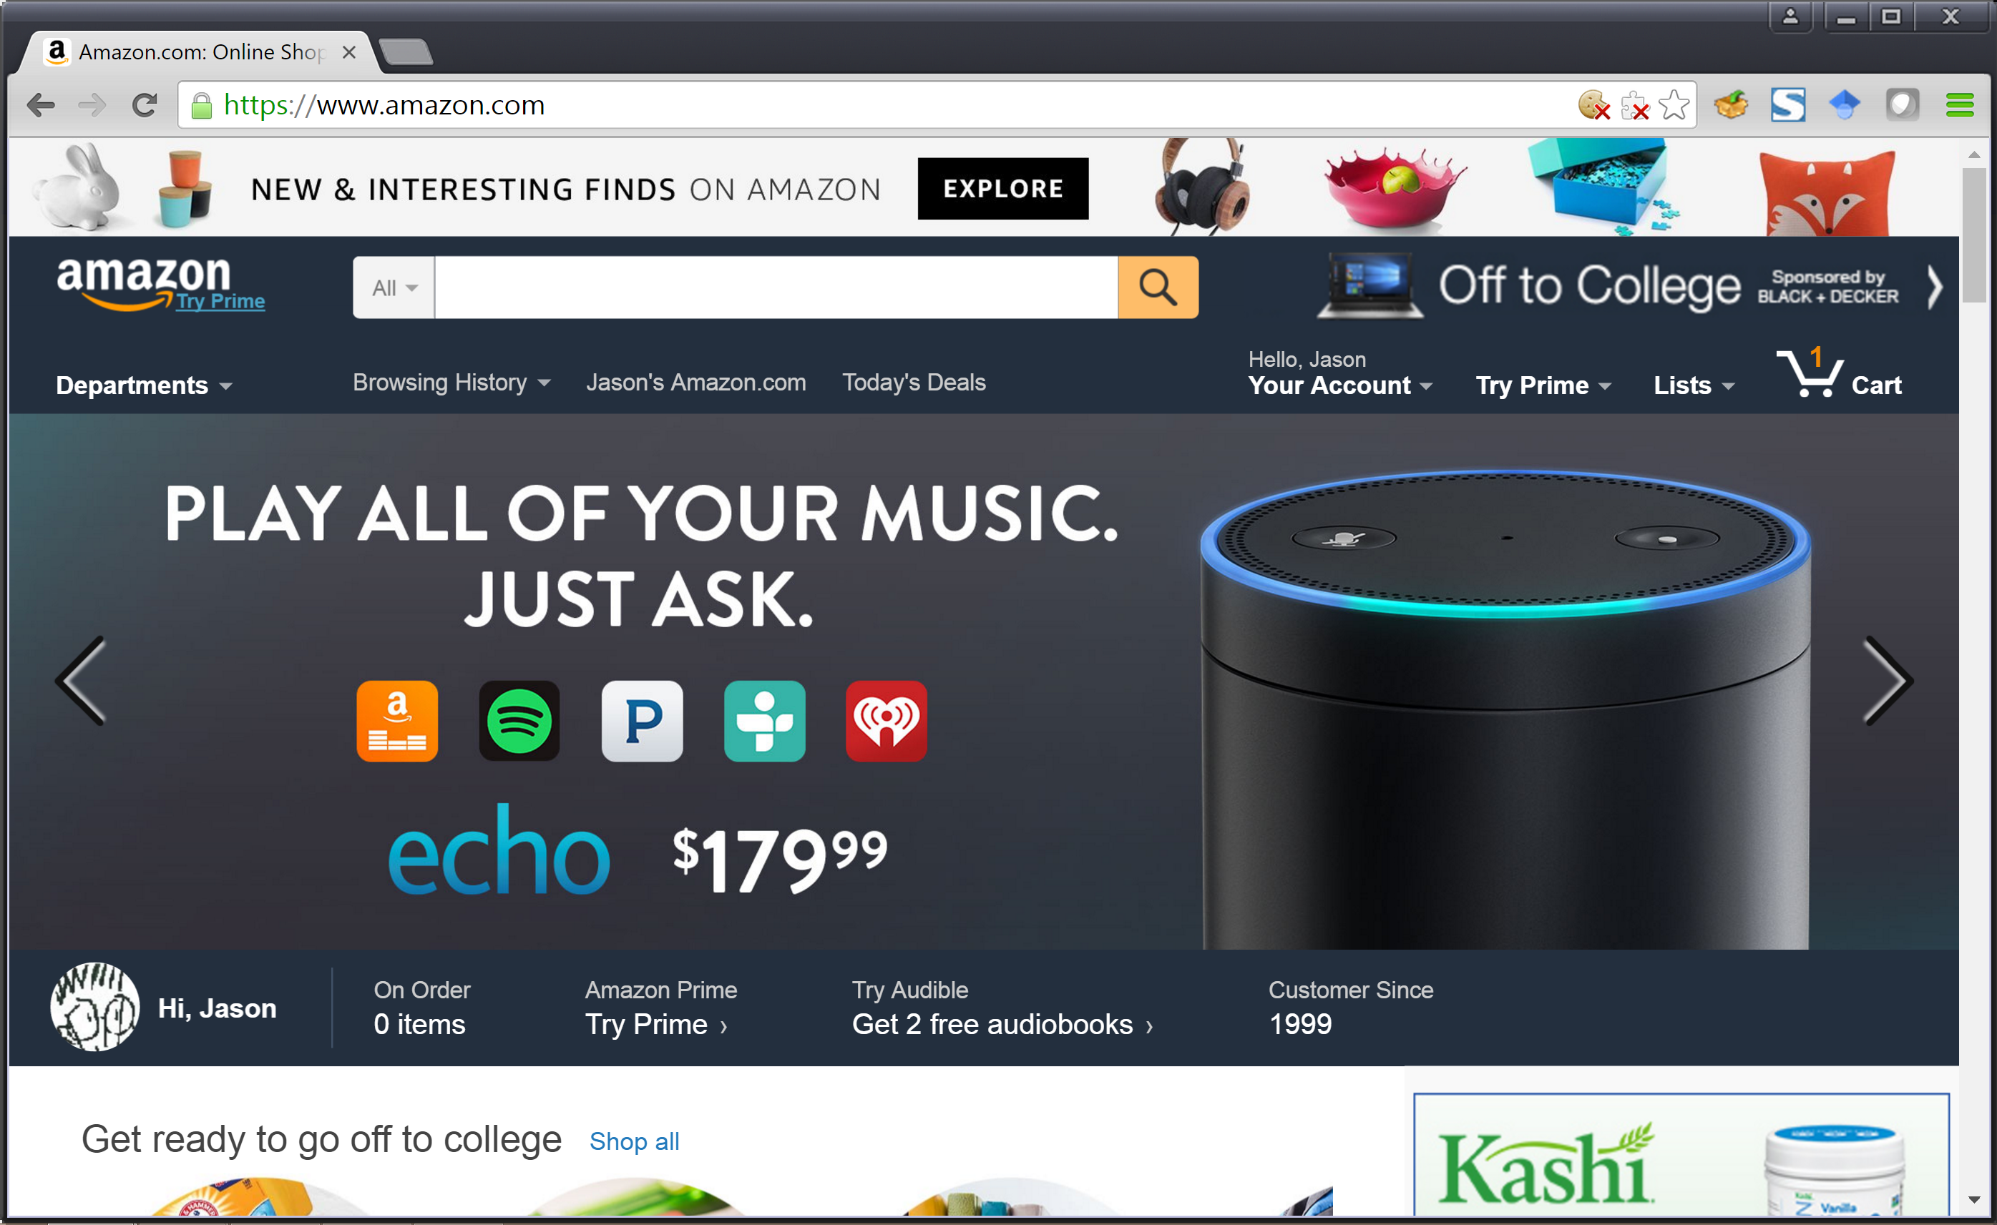
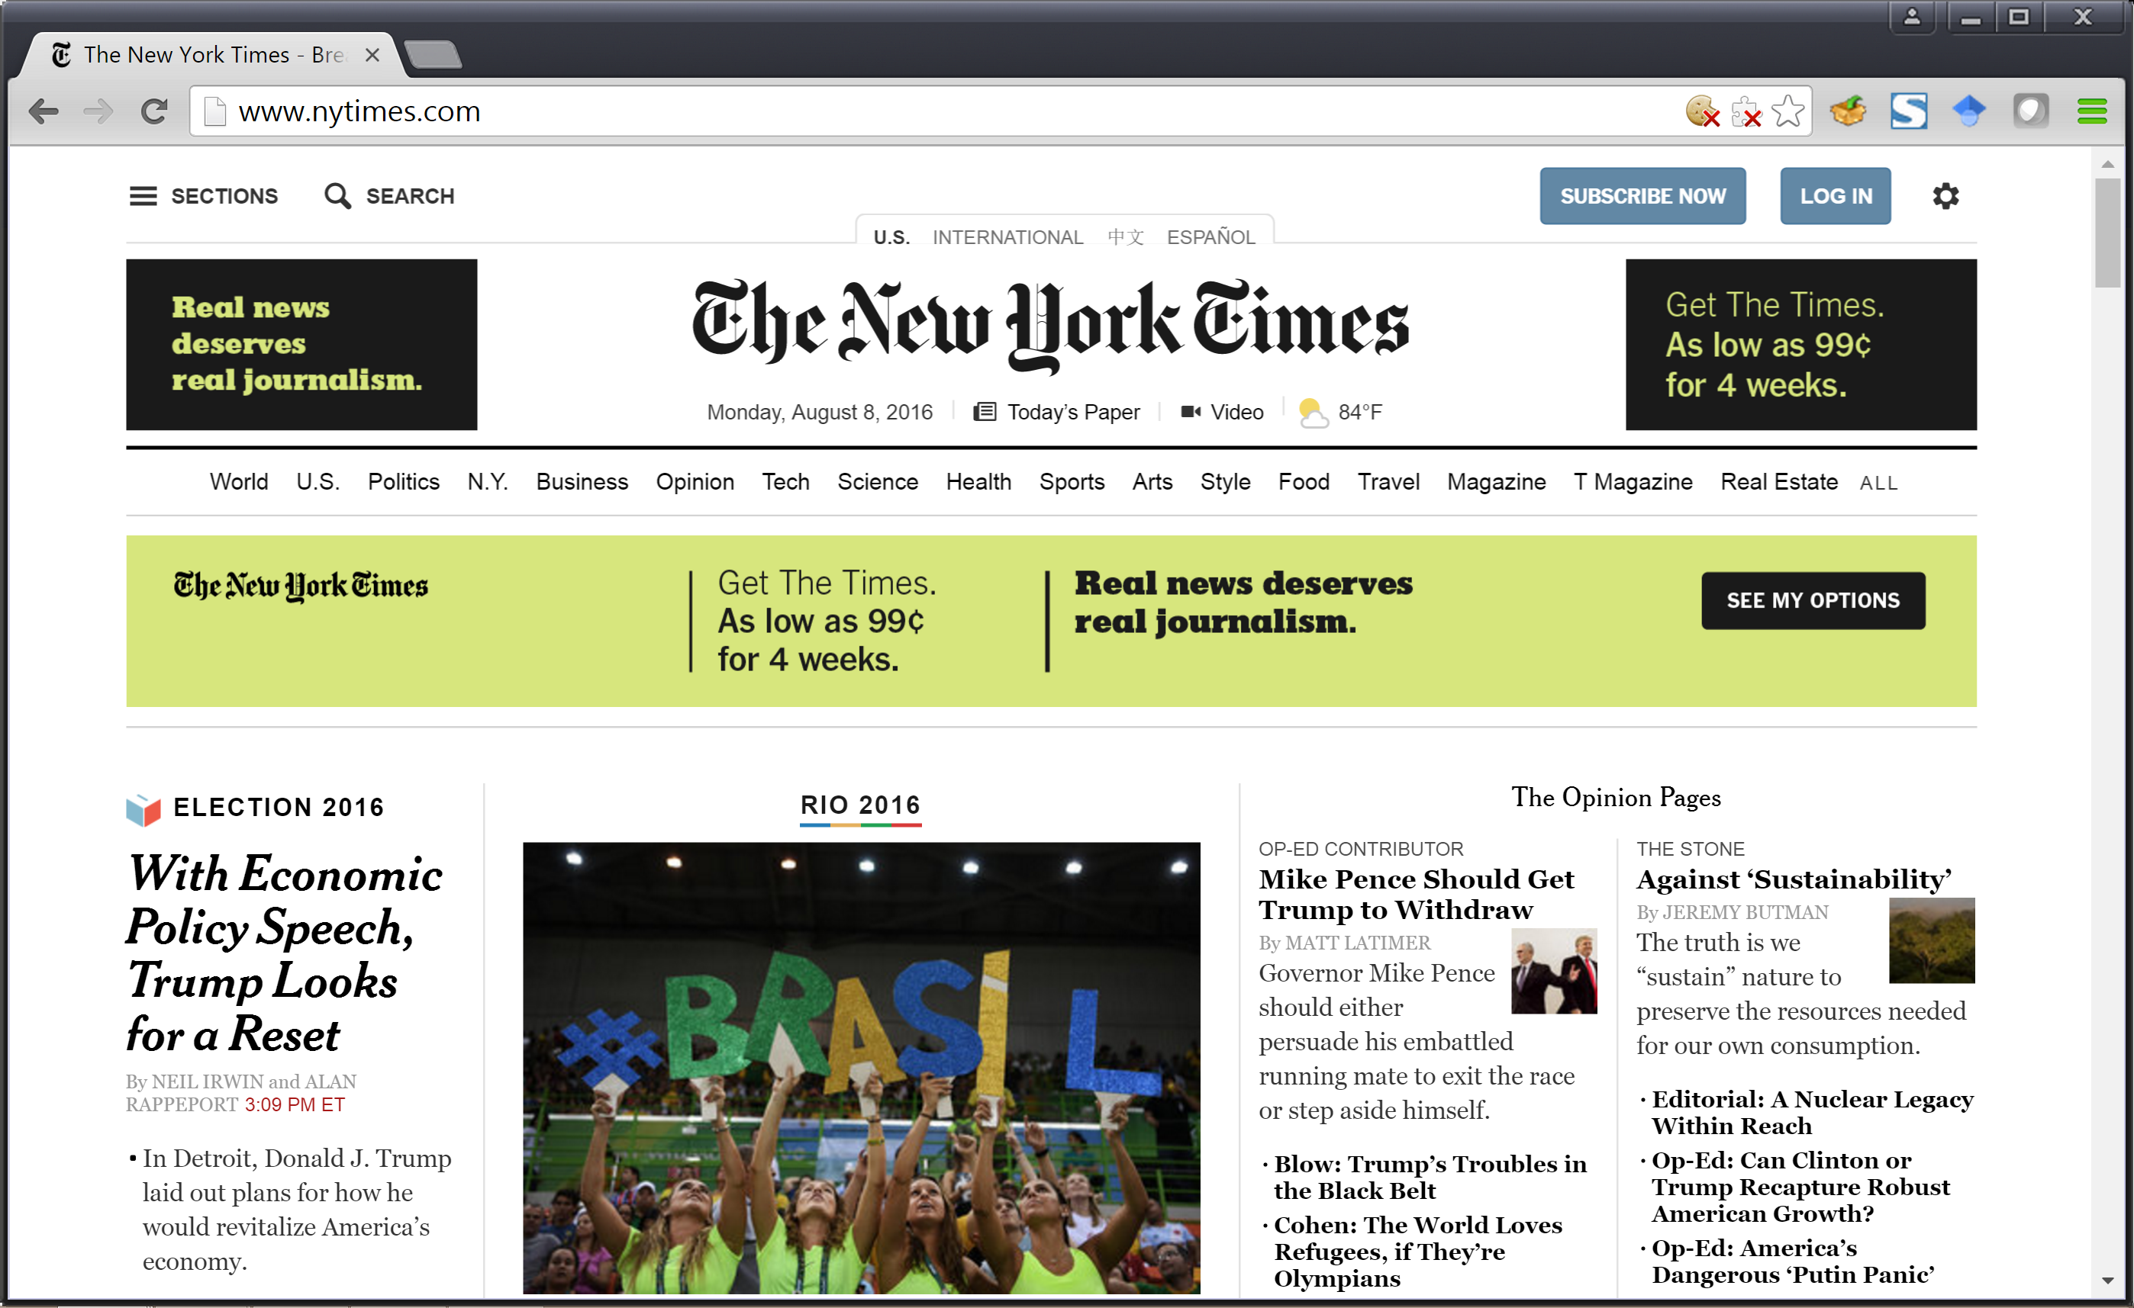
What Do These Have in Common?

Slide 13
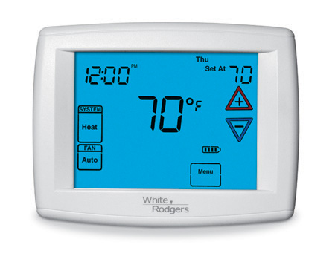
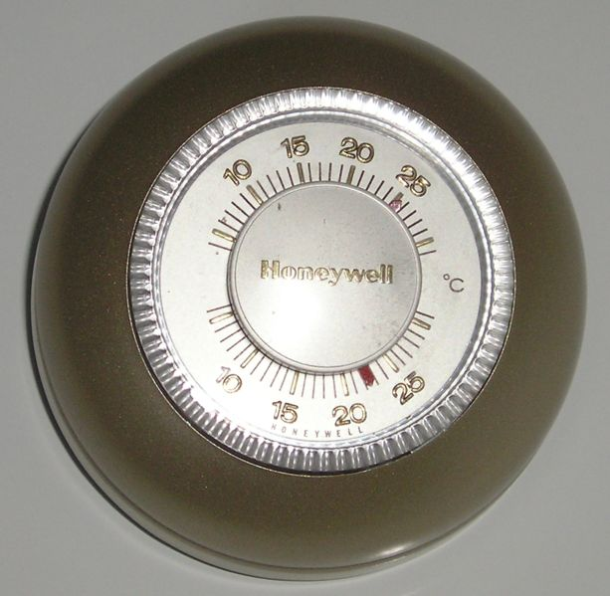
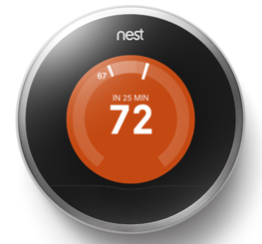
What Do These Have in Common?

Slide 14
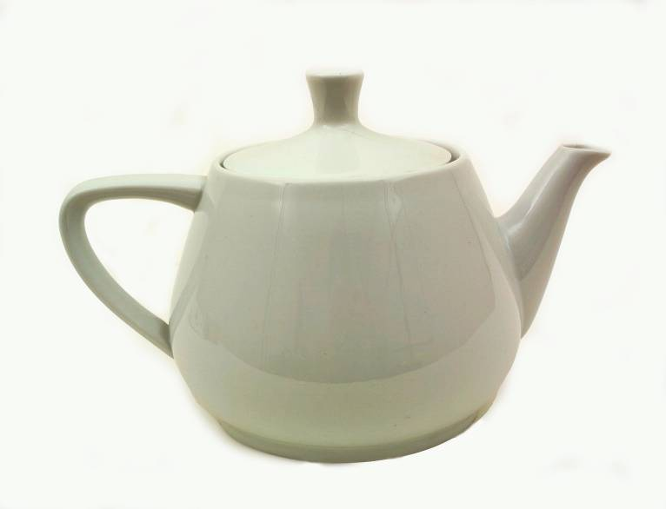

What Do These Have in Common?

Slide 15
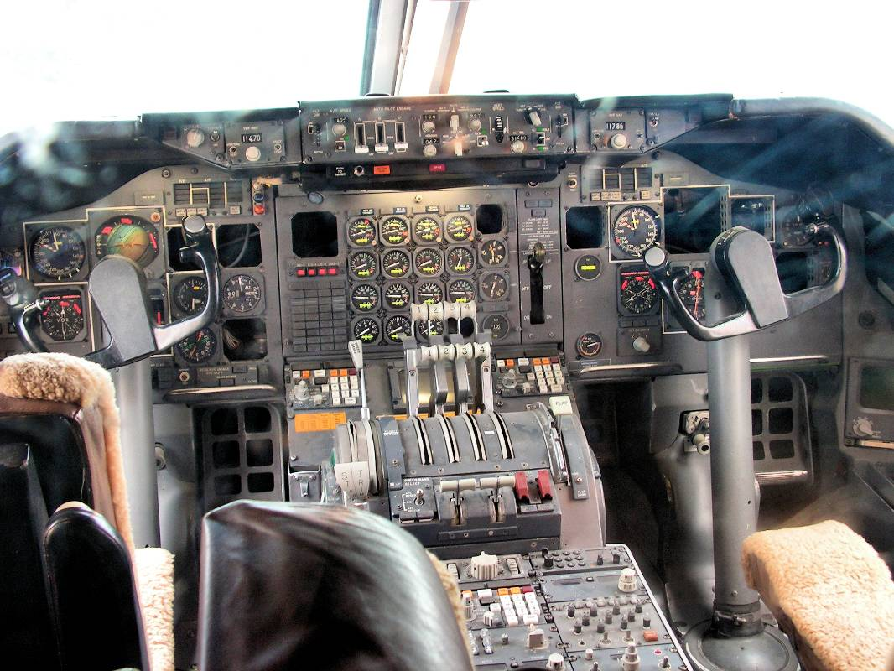
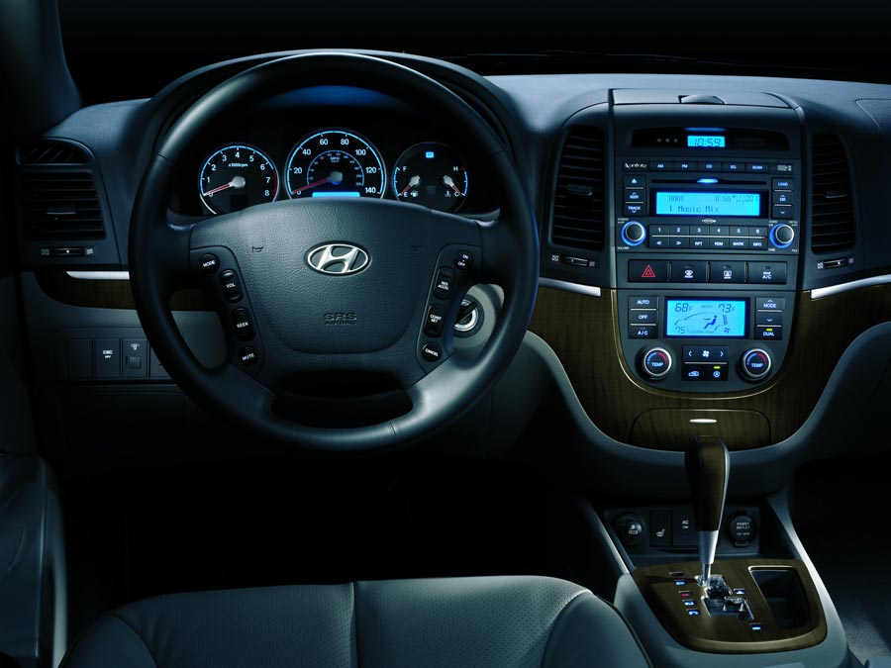
What Do These Have in Common?

Slide 16


What Do These Have in Common?

Slide 17
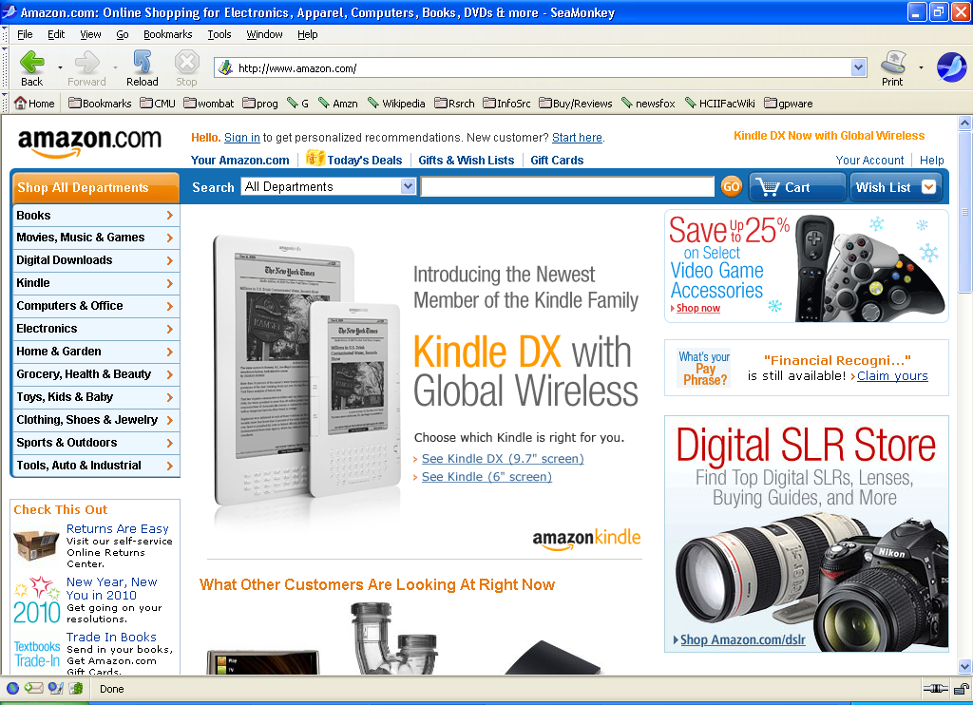
What Do These Have in Common?
They are all designed by people
They are all used by people
Notes:
These were all designed by people
These are all used by people
On the surface, this is a trivial statement, but look around you, and think about the sheer number of things that are designed. The pens and pencils you are using. The desks you are sitting in. The mobile phones you have. The clothes you are wearing. The lighting in this room. The projector. The windows. The entire building. The entire campus. With the exception of nature, almost everything we use and interact with has been designed by someone, and is used by someone.

Slide 18
Goals of this Class (1/3)
Everything designed has some explicit criteria
Attractive
Cost effective to manufacture
Durable
Safe to use
Can hold hot water effectively
Separate tea leaves from the tea
This class: How to implement interactive designs that are useful, usable, and desirable?

Slide 19
Goals of this Class (2/3)
Experience in rapid prototyping
Skills, understand what’s easy vs hard
Express one’s ideas in a computational form
Modern prototyping tools & HTML + CSS + JavaScript
(SSUI Lab - Section D) More advanced web topics
Responsive design, back-end, animation, etc
Basic terminology and approaches used by devs, so you can work effectively with them
Experience joy and frustration of programming (and debugging) working prototypes
Notes:
SSUI: Deeper understanding of how tech works

Slide 20
Goals of this Class (3/3)
Basics of human perception and cognition as it relates to UX design
Ex. Color, grouping, mental models, more
Design and conduct informal user tests of prototypes to find flaws with your interfaces
Get a taste for the future of HCI and UX design

Slide 21
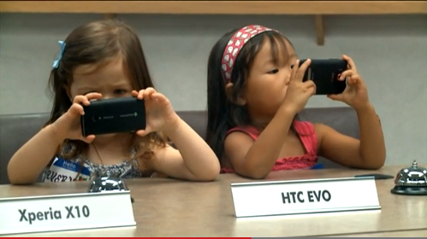



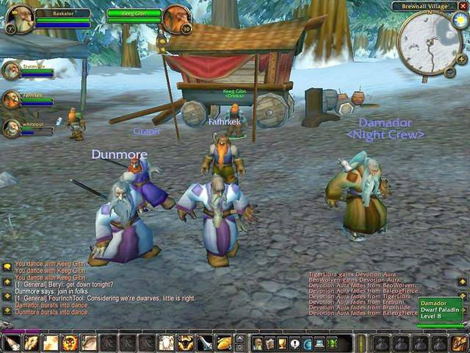
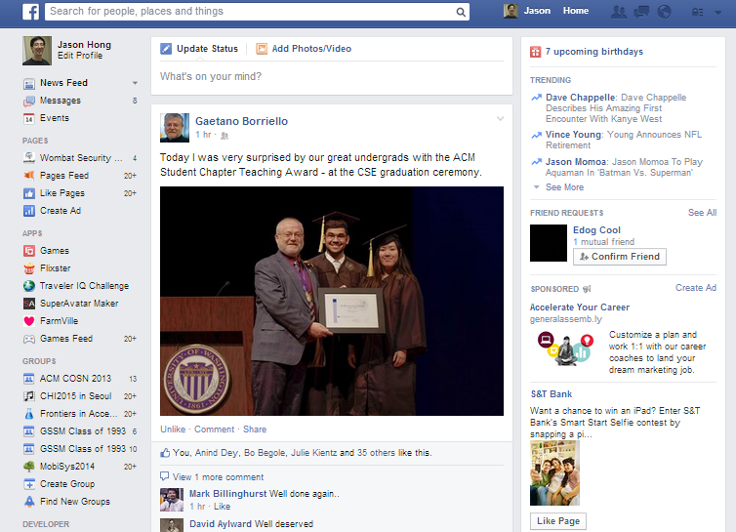
Interactive Computing Today is Desktop, Web, and Smartphone

Slide 22
But Interactive Computing Starting to Break Out into Physical World
We are in the early parts of third phase of computing
First: computation
Second: communication
Third: Ubiquitous computing Pervasive computing Internet of Things

Slide 23

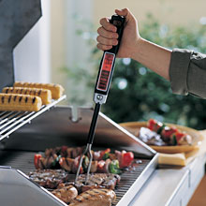


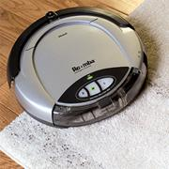
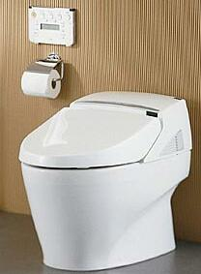
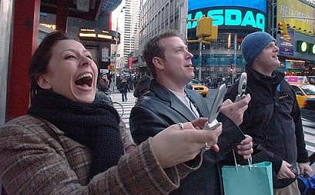
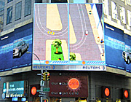
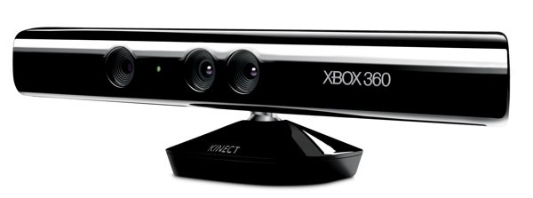
Computing is Everywhere
Notes:
But here is a less obvious but also possible future
http://images.google.com/imgres?imgurl=www.computer.org/micro/homepage/may_june/shenck/m3shen05.gif&imgrefurl=http://www.computer.org/micro/homepage/may_june/shenck/01a.htm&h=289&w=350&sz=44&tbnid=HAGagqqv7OUJ:&tbnh=95&tbnw=115&start=1&prev=/images%3Fq%3Drfid%2Bshoes%26hl%3Den%26lr%3D%26ie%3DUTF-8%26sa%3DG
http://www.geocities.com/hightechcats/
I don’t make this stuff up…

Slide 24
Some New UX Design Challenges
Autonomous vehicles
How to interact with passengers and pedestrians?
Artificial intelligence
Best combination of people and computers?
Ex. Doctors making diagnoses
Conversational UIs
How to interact with voice only?
What happens when intelligent agents everywhere?
Information visualization
How to understand millions or billions of data points?
Notes:
These are still ongoing research problems, and part of the goal of this class is to give you a flavor of what researchers have already done, to give you a taste of the possible future of interactive computing

Slide 25
Syllabus and Course Resources
Available via Google Docs (save some trees)
https://goo.gl/wrvhry
Has links to the other items below
Canvas
https://canvas.cmu.edu/courses/6395
Use for getting slides and submitting homeworks
Piazza
http://piazza.com/cmu/fall2018/0543005630
Use for asking and answering questions
Use this link to add yourself
Update this each semester

Slide 26
Prerequisites
PUI (Sections A, B, C)
At least intro to computer science / programming
“Can successfully write a 300 line program in 48 hours”
Note: This is HW0 due on Friday
SSUI Lab (Section D)
Extensive programming experience
We expect students to already have basic knowledge of HTML and CSS
If not, Khan Academy, Codecademy, w3schools, etc
Start learning basics of HTML and CSS on your own
Will have a refresher in one of the labs

Slide 27
Prerequisites
What you should know about HTML
Can put together a very basic web page
Understand how to use <div> <a> <img> <p>
How to include a CSS file in the HTML
… CSS
Setting background color, font, size
… JavaScript
None (but require familiarity with intro programming)
Variables, loops, arrays, functions / methods, sorting

Slide 28

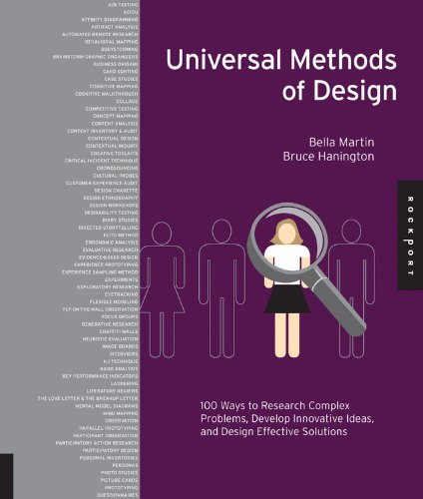
Textbooks
Required
(Older versions ok)
Recommended

Slide 29
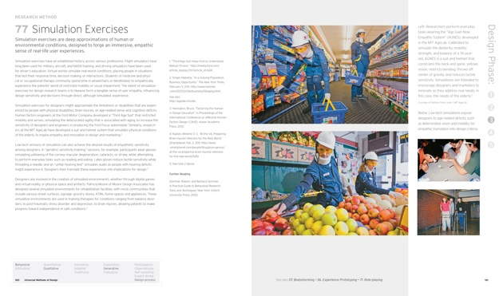

Slide 30
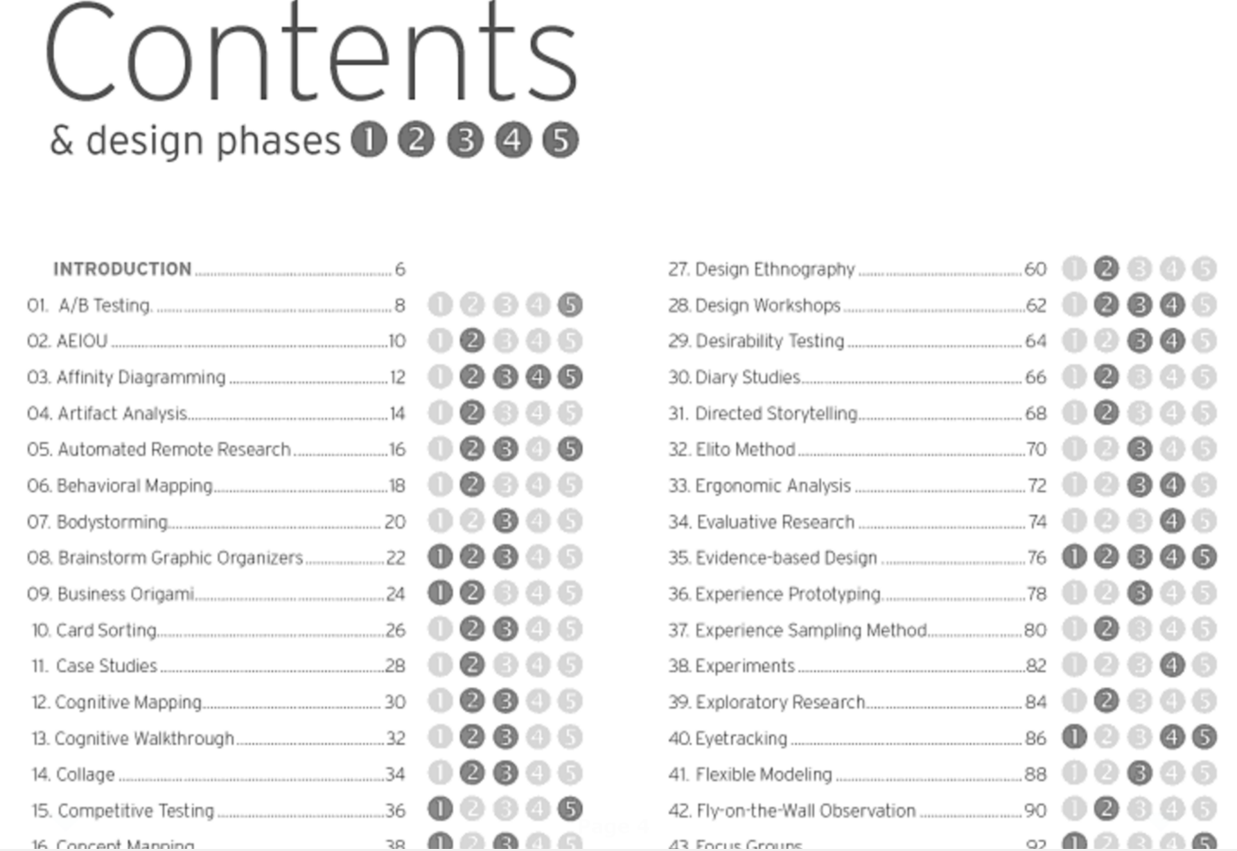

Slide 31
Readings
There will be some online readings, see syllabus
Do readings before class they are listed on
Some readings are for a working textbook
Some require using campus network or VPN
https://www.cmu.edu/computing/network/vpn/
Yes, content will be on exams, even if not discussed in class
Also, in-class unannounced quizzes at start of class too based on readings (more on this later)

Slide 32
Attendance (1/5)
Rather than taking attendance, will ask questions about class on midterm and final
Ex. discussion topics, insightful questions, interesting videos, presentations, bad jokes, etc
Ex. Answer 10 of 12, so you can miss some classes for job interviews, if sick, etc
Examples:
“In the Luxo Jr video shown in class, what did he stomp on and break?”
Jeff Hawkins carried a block of wood, which he used to help him invent _______

Slide 33
Attendance (2/5)
Lab attendance
Lab attendance mandatory
Can miss up to 2 labs w/o affecting your grade
Will use some software to track attendance
Notes:
https://theamericanscholar.org/solitude-and-leadership/

Slide 34
Attendance (3/5)
No laptops in class
Study from Stanford, article in The American Scholar
“The investigators wanted to figure out how today’s college students were able to multitask so much more effectively than adults.”
“[P]eople do not multitask effectively. And here’s the really surprising finding: the more people multitask, the worse they are, not just at other mental abilities, but at multitasking itself.
“Multitasking, in short, is not only not thinking, it impairs your ability to think.”
Notes:
https://theamericanscholar.org/solitude-and-leadership/

Slide 35
Attendance (4/5)
No laptops in lecture
Other studies show people using laptops good at factual knowledge but not conceptual
Harder for you to learn, wastes your time and ours
Disruptive to others around you
Do bring laptops to lab though
We’ll have printouts
So you can annotate
And some in-class exercises
Notes:
http://www.chronicle.com/article/The-Benefits-of-No-Tech-Note/228089

Slide 36
Attendance (5/5)
Final exam time only scheduled by university a few weeks after start of class
Do not schedule any trips home until you know your exam schedule

Slide 37
Academic Honesty
CMU policies on academic honesty and plagiarism apply to this course
Don’t submit content that isn’t yours
Document any in-depth discussions of help

Slide 38
Academic Honesty Acceptable Activities (1/2)
Trying out apps / web sites related to the assignment to get design ideas
Reading reviews of related apps / web sites to get ideas of problems people face
Drawing on and using design patterns from related apps / web sites

Slide 39
Academic Honesty Acceptable Activities (2/2)
Showing and discussing prototypes with others
But not actual code
Best to only show on your computers b/c trivial to view web source
Discussing the concepts or examples of how a prototyping tool / web programming works
Searching for examples on how to use a specific programming API
Discussing assigned readings

Slide 40
Academic Honesty Not Acceptable Activities
Sharing code or content you created for an assignment with someone else in this class
Using the code or content that another person in this class created
Using code taken from other web sites (code libraries that are meant to be reused are ok)
Using media content from other sites
Exception for Creative Commons or public content
Paying people to do your homework

Slide 41
Special Needs
If you are will be missing class for religious reasons, let us know during the first week of class
If you have a disability and wish to request an accommodation, please contact the Equal Opportunities Services and Disability Resources.

Slide 42
Waitlist
Update each semester
Currently 99 students enrolled, 32 waitlist
Will cap course to 104 students (#seats)
If might drop course, please drop early to let others in
Priority for waitlist
Students who need the course to graduate
Let us know asap if this is the case
Students graduating this semester (grad or ugrad)
Everyone else
Note: for HCI minors, lots of overlap with DHCS, suggest taking a different course instead

Slide 43
Homework and Quizzes
Homeworks will be mostly programming assignments
Regular unannounced quizzes will be handed out at beginning of class based on readings and other course content
No make-up quizzes will be allowed if you are not in attendance when a quiz is handed out (be on time)
Average of quiz scores will go toward extra credit
So ok if you miss quizzes

Slide 44
Grading
Extra credit is 2% quiz, 1% extra optional assignment at end of semester
Lab Grade (includes homeworks) | 60%
Final Exam | 20%
Midterm | 20%
Extra Credit | 3%

Slide 45
Schedule of Topics
See Google doc of syllabus
https://goo.gl/wrvhry
Note that course topics and labs are aligned in first half of semester
Prototyping, HTML / CSS / JavaScript
But diverges in second half
Update link each semester

Slide 46

Other Advice for this Course Programming Experience
Many of you have minimal programming experience

Slide 47
Other Advice for this Course Programming Experience
Many of you have minimal programming experience
This is ok, this course is geared for you
We have great TAs
Lots of online tutorials and content to help
Khan Academy tutorials on HTML, CSS, and JavaScript
CodeCademy on HTML, CSS, JavaScript, and JQuery
W3Schools has many examples of web programming
Lynda tutorials (free for CMU students)
About a month before we get to programming

Slide 48
Other Advice for this Course What You’ll Get From This Course
In 2015, one MHCI student interviewed current students and alums to understand anxieties and (incorrect) expectations
"Learning means being given steps, like a recipe.”
“Why don’t they teach us the rules for design?”
This is not what this (or other) courses are about

Slide 49
Other Advice for this Course What You’ll Get From This Course
Very few things in HCI/UX design (or even life!) have clear steps or clear answers
Often must balance multiple competing constraints
Few hard rules for HCI and UX, no overarching theory
People and technology are complex
HCI/UX draws on nearly every aspect of human experience
Behavioral, Design, Tech, LearningSci, Anthro, Business, Art, Ethics, Public Policy, and much more
And tech and tools advancing every year

Slide 50
Other Advice for this Course What You’ll Get From This Course
The MHCI program was supposed to make them an “expert” at ________.
You won’t become an expert at prototyping with just one course. But you’ll become very good at prototyping and well ahead of competition.

Slide 51
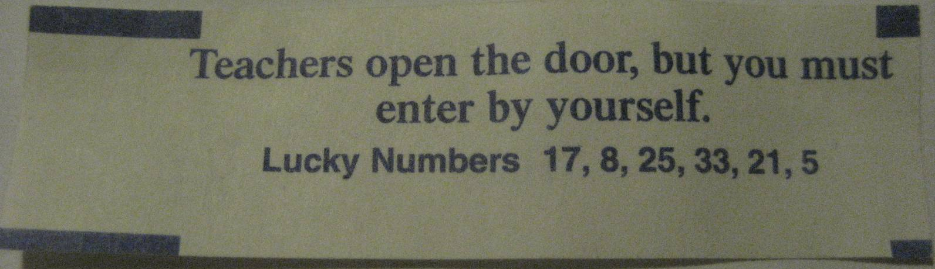
Other Advice for this Course What You’ll Get From This Course
The MHCI program would guide them through every method for every subject.
Too many methods, no one can master them all
We can help you get practical skills and tools for thinking like a UX designer

Slide 52
Other Advice for this Course Grades
Please don’t ever ask what you need to do to get an A in this course
Steve Jobs would never ask this question
Picasso or van Gogh would never ask this question
Life is not like this, and very rarely is there clear criteria
Lots of people thought iPhone and iPad were stupid
Use this as a safe space for exploring and engaging with ideas, sharpening your skills, and pushing yourself

Slide 53
Other Advice for Your Time at CMU Be Active in Your Learning
Easy to just go to class, get a grade, but not really learn
Be active in your learning
Ask questions in class
Hold your fellow students to high standards
Go to HCI seminar talks (Fri at 1:30pm NSH 1305)
https://hcii.cmu.edu/news/seminars
Think of your classes as opportunity to learn more about world and better yourself
Teach us!

Slide 54
Other Advice for Your Time at CMU
Take a risk on things
This is a safe space to try to push yourself

Slide 55

Notes:
2013 movie

Slide 56
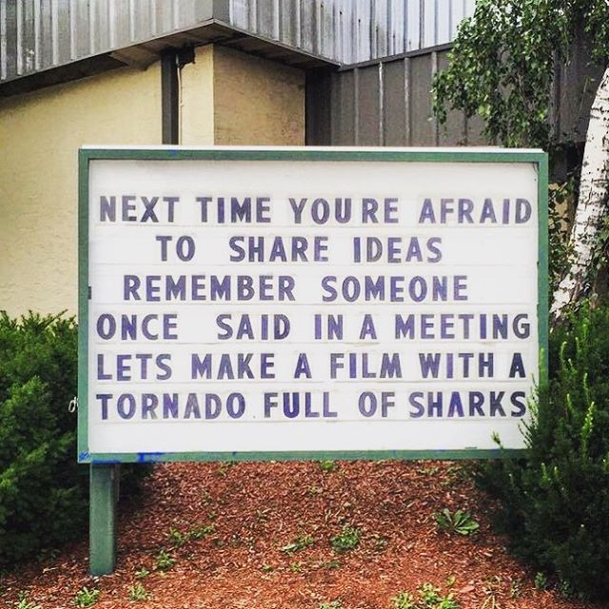

Slide 57
Other Advice for Your Time at CMU
Take a risk on things
This is a safe space to try to push yourself
It's ok to be wrong, just don’t stay wrong

Slide 58
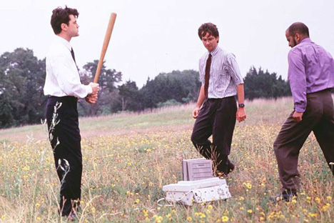

Reading for Wednesday
Phil Agre’s “How to Help Someone Use a Computer” http://polaris.gseis.ucla.edu/pagre/how-to-help.html

Slide 59
Homework 0
Short test on basics of programming
Closed book, don’t look up things online or in books
Don’t ask anyone for help (online or in person)
HW assignment on Canvas
Due: Fri Aug 31 @ 11:59pm
Instructions on how to submit
https://goo.gl/tCvLkr (for folks on waitlist)
If fail, it means you don’t pass the basic prerequisites and can’t take the course
Update due date

Slide 60
Homework 1
Example of a good UI or a bad UI (choose one)
1 picture
5-10 sentences, 1 page total
HW assignment on Canvas
Due: Fri Aug 31 @ 11:59pm
Instructions on how to submit
https://goo.gl/CmZicV (for folks on waitlist)
Update due date

Slide 61
Action Items (1/2)
HW0 and HW1 assigned
Good UI / Bad UI due Fri Aug 31 at 11:59pm
Do reading for Wednesday
How to Help Someone Using a Computer
http://polaris.gseis.ucla.edu/pagre/how-to-help.html
Important Links
Syllabus https://goo.gl/wrvhry
Canvas https://canvas.cmu.edu/courses/6395
Piazza http://piazza.com/cmu/fall2018/0543005630
Update this each semester

Slide 62
Action Items (2/2)
Get course book
Design of Everyday Things (required)
Universal Methods of Design (optional)
Waitlist
If might drop course, please drop early to let others in
If on waitlist and need course to graduate, let us know
Will finalize waitlist by Thursday
Optional
Start tutorials on HTML and CSS on your own
Start tutorials on JavaScript and JQuery too
We won’t get to these for about a month

Slide 63

Questions

Slide 65
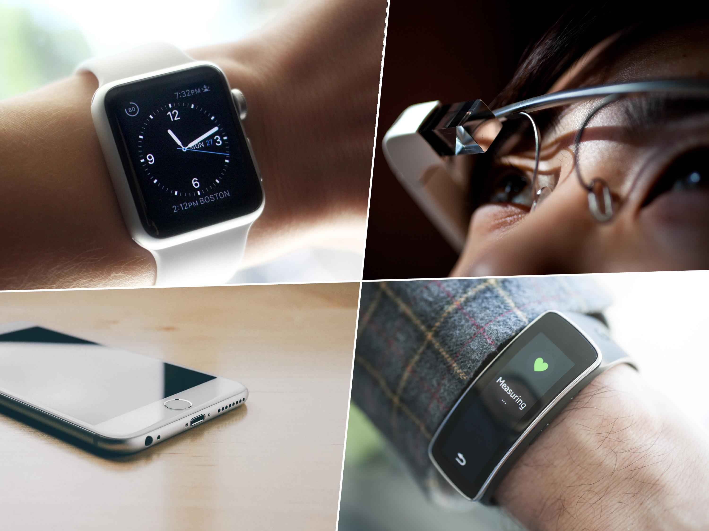
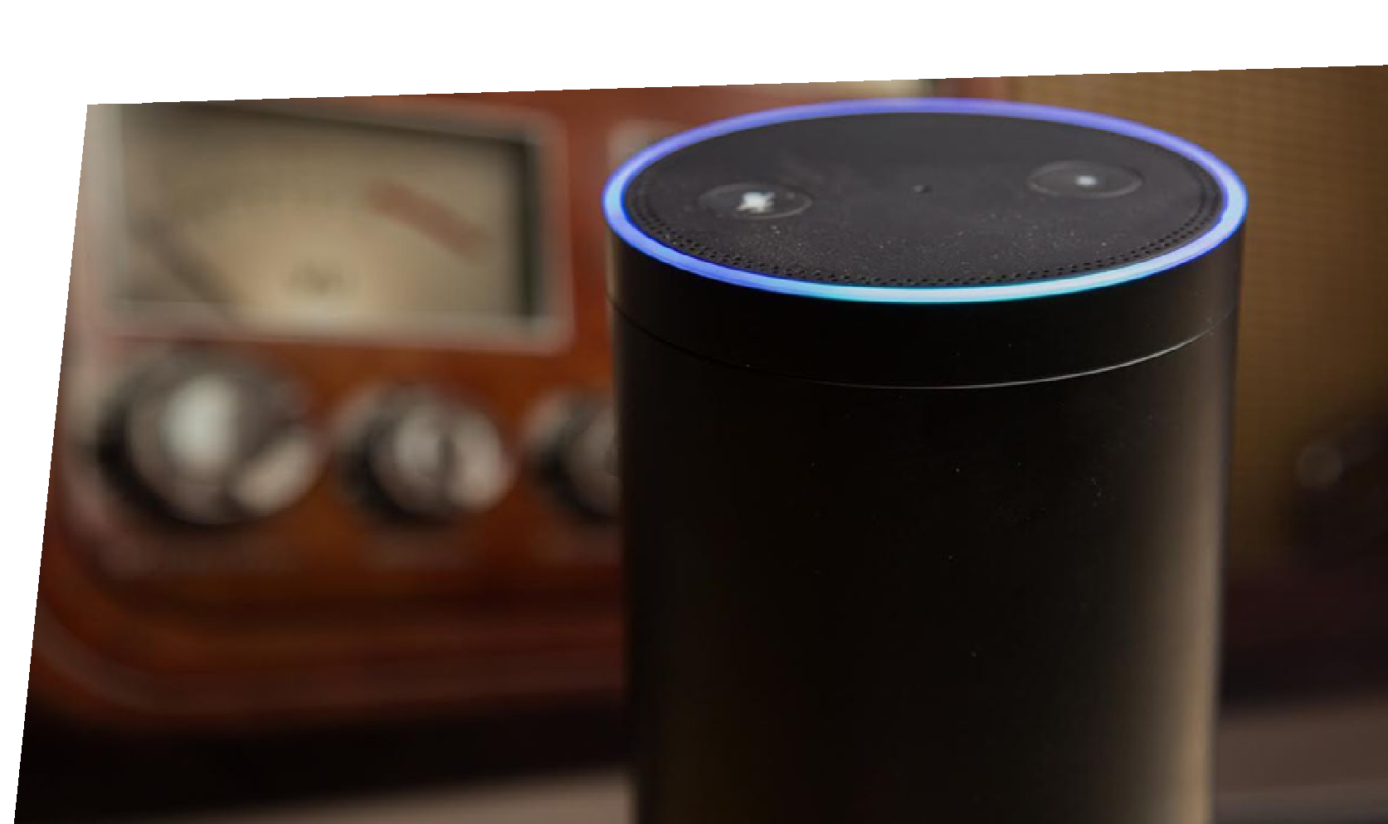
Notes:
Today, computers come as smartphones, tablets, glasses, cars, watches, clothes, fitness trackers, health monitoring devices, parking meters, electronic locks, smart mirrors, drones, and more.

Slide 66
Waitlist
This year is an experiment
Combine PUI (for non-programmers) with SSUI (for programmers) since course overlap is high
But this also means this class is very full
So odds of getting off waitlist is low
Priority will be for MHCI and BHCI students
Will make decisions by end of this week
Go to Lab and submit HW0 in the meanwhile
Will teach PUI again in the spring (but not SSUI)
If you’re not serious about this course or can wait til spring, help others out and drop early

Slide 67
Scaife Hall Constraints
We will be at full room capacity for this course
This means that we need you to squeeze in, no empty seats between folks

